Slide 1
The DAO Pattern
Implementing a Data Access Layer

Slide 2
A Note on Code Design
  We currently interact with the database straight from our “front-end” code
    This is bad practice!
  A key concept for software development is to ensure the separation of concerns – all code should be separated/grouped based on its logic
  “Front-end” (i.e. user-interacting) code should focus on:
    Displaying data to the user
    Taking and validating data from the user
  Logic code should focus on the “thinking” of the program
    Database interaction is part of the “thinking”

Slide 3
Extracting Data Access:
The Data Access Object (DAO) Pattern
  The Data Access Object (DAO) pattern is a design pattern designed to separate data persistence logic from business logic
Our Code
DAO acts as a middleman
MyClientCode
Request a Customer object from the CustomerDao object
CustomerDao
Database
Uses JDBC

Slide 4
Why Use the DAO Pattern?
Improve the Overall Design
  Separation of concerns: Each section of code is concerned with its own area
    The only code that needs to know the details of the data persistence are the data access classes
  Maintainability: Improves the process of maintaining the system.
    Any changes needed to the data persistence logic should only impact the data access level.
    Other classes are not involved as they don’t know the details
Front End
Business Logic
DAO Layer
Database

Slide 5
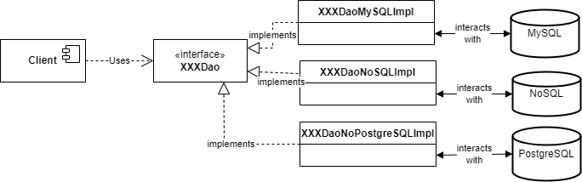
Why Use the DAO Pattern?
Open Up the System’s Design
  Flexibility: The DAO patterns employs interfaces to standardise behaviours in a flexible manner.
    This allows for access provision across multiple data sources if necessary.
    Can implement the behaviours for several different databases, all without changing the main business logic.

Slide 6
Why Use the DAO Pattern?
Design for Software Quality
  Testability: The DAO pattern turns data persistence code into easily testable methods.
    The more easily testable code is, the more robust it can be.
  DAO pattern improves ability to:
    Mock the database when unit testing the persistence code.
    Mock the persistence logic when testing non-persistence code.

Slide 7
Key Components of the DAO Pattern
  DAO interface – blueprint of standard behaviour for the data access object.
  DAO implementation – implementation of the operations listed in the interface
    There can be many of these for a single data type
  DTO – data transfer object
    Stores data as it is transferred to/from the database

Slide 8

How Does the DAO Pattern Work?
<<interface>>
CustomerDAO
Interface lists/states required methods in all CustomerDAO objects
uses
implements
Database
CustomerDaoImpl
Client
SEQUENCE OF EVENTS
Client code creates DAO object & runs DAO method.
DAO queries DB & makes Customer object(s) based on results
DAO returns Customer(s) to client code.
creates/uses
obtains/
modifies
Customer

Slide 9
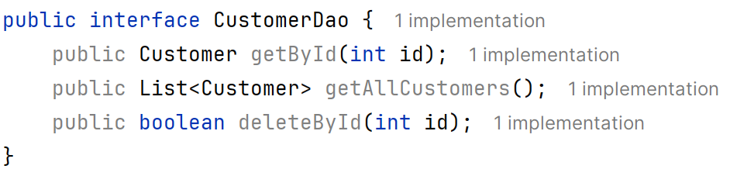
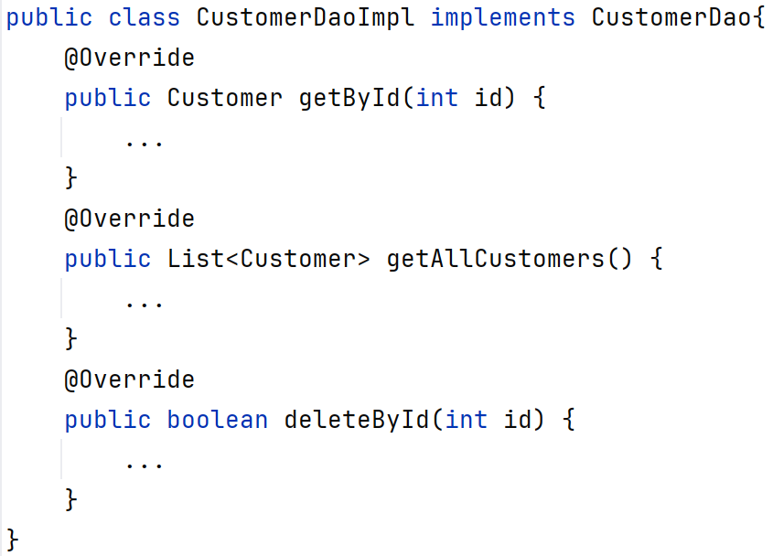
The DAO Pattern in Code
The interface defines the abilities of the DAO
The implementation defines how each version of that DAO will provide those abilities

Slide 10
Drawbacks of the DAO Pattern
  Increased complexity: Adding layers to the codebase means the code has to follow specific rules and structures
    Can’t freeform the approach as much
  Potential increase in overheads
    Going through multiple layers of code to carry out an action means the action is carried out slower

Slide 11
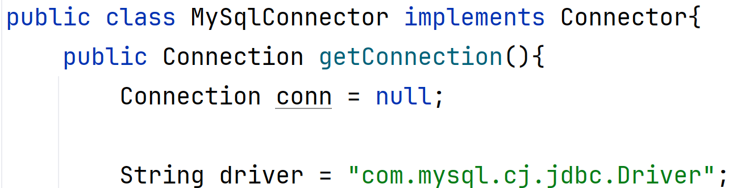
Reducing Repetition in DAOs
  Every implementation needs to generate database connections as part of their behaviour
  Reduce repetition: Extract connection logic out into a separate class
    Put an interface on that class so that you can have different implementations for different situations!
Etc…

Slide 12
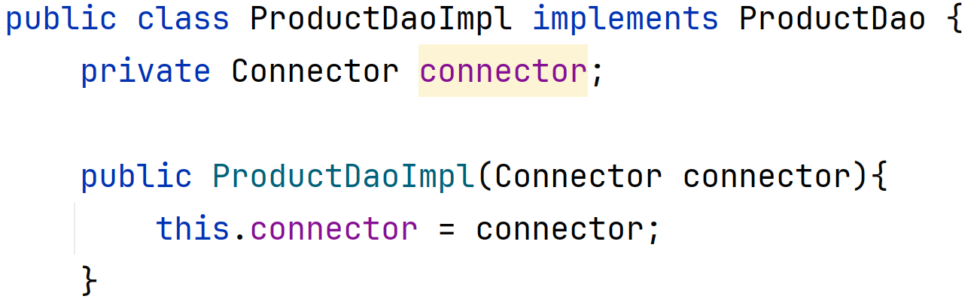
Improving System Flexibility With Dependency Injection
  Dependency injection (DI):
    Storing a dependency object as an attribute of the class
    Taking that object in as an initial constructor parameter
  This replaces creating an instance directly within the code
Notes:
Dependency object: Something your code uses/depends on to carry out some action.

Slide 13
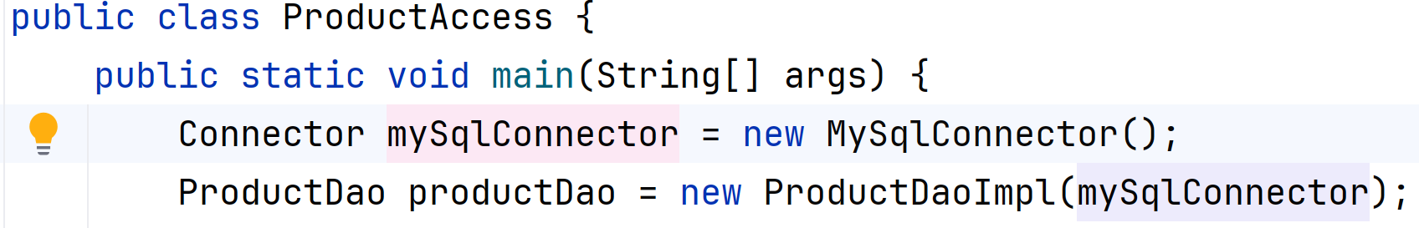
Injecting the Dependency
  By using DI, we can set the connector version being used when we create the DAO
    Don’t need to change the DAO code itself to work with a different connection source, e.g. a different database or a mock database connection

